Slide 1
Leonardo of Pisa

Slide 2
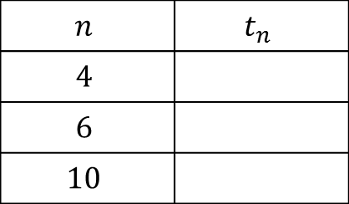

Leonardo of Pisa
The $n^{th}$ term of a sequence is given by:
$t_{n}= \frac{1}{\sqrt{5}}{\left(\frac{1+\sqrt{5}}{2}\right)}^{n}− \frac{1}{\sqrt{5}}{\left(\frac{1−\sqrt{5}}{2}\right)}^{n}$
Work out the terms for the values of $n$ shown.
$$n$$ | $$t_{n}$$
$$4$$
$$6$$
$$10$$

Slide 3
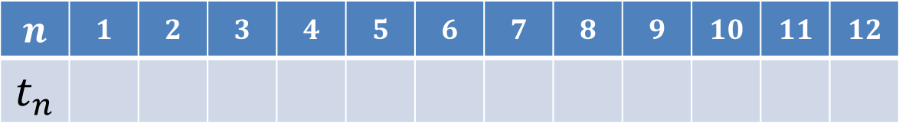
$$n$$ | $$1$$ | $$2$$ | $$3$$ | $$4$$ | $$5$$ | $$6$$ | $$7$$ | $$8$$ | $$9$$ | $$10$$ | $$11$$ | $$12$$
$$t_{n}$$

Slide 4
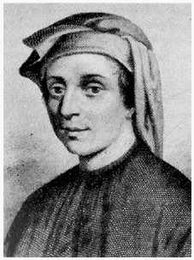
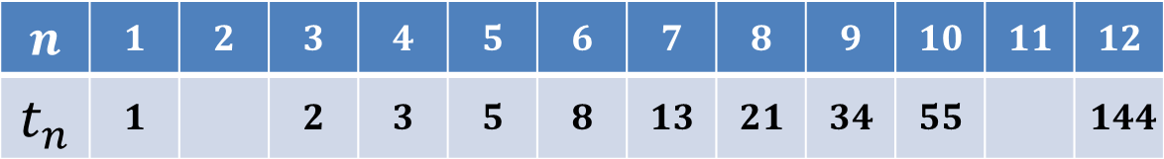
We should now have the following results:
Can you fill in the gaps?
Have you seen this sequence before?
It is the Fibonacci sequence
$$n$$ | $$1$$ | $$2$$ | $$3$$ | $$4$$ | $$5$$ | $$6$$ | $$7$$ | $$8$$ | $$9$$ | $$10$$ | $$11$$ | $$12$$
$$t_{n}$$ | $$1$$ |  | $$2$$ | $$3$$ | $$5$$ | $$8$$ | $$13$$ | $$21$$ | $$34$$ | $$55$$ |  | $$144$$

Slide 5
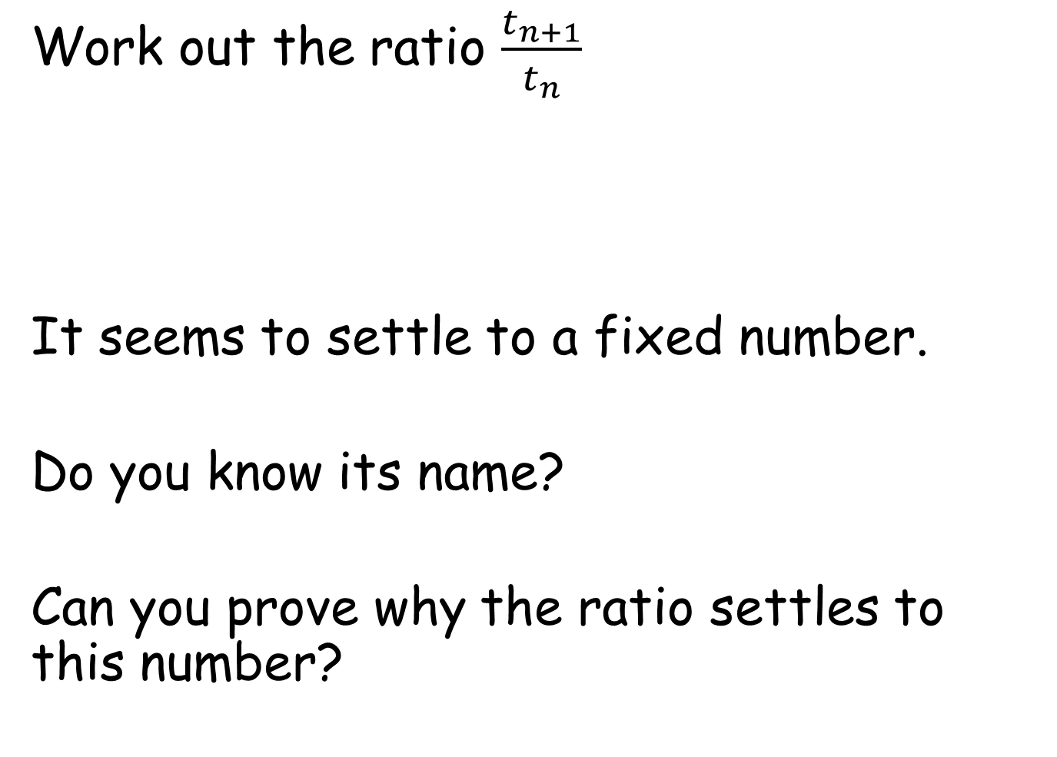
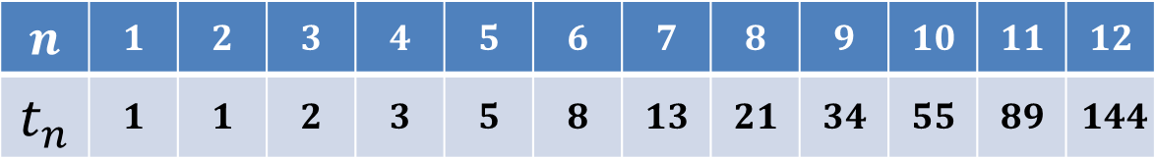
Work out the ratio $\frac{t_{n+1}}{t_{n}}$
It seems to settle to a fixed number.
Do you know its name?
Can you prove why the ratio settles to this number?
$$n$$ | $$1$$ | $$2$$ | $$3$$ | $$4$$ | $$5$$ | $$6$$ | $$7$$ | $$8$$ | $$9$$ | $$10$$ | $$11$$ | $$12$$
$$t_{n}$$ | $$1$$ | $$1$$ | $$2$$ | $$3$$ | $$5$$ | $$8$$ | $$13$$ | $$21$$ | $$34$$ | $$55$$ | $$89$$ | $$144$$
$$ratio$$ |  | $$1$$ | $$2$$ | $$1.5$$ | $$1.6667$$ | $$1.6$$ | $$1.625$$ | $$1.6154$$ | $$1.619$$ | $$1.6176$$ | $$1.6182$$ | $$1.618$$
Notes:
Go to spreadsheet

Slide 6
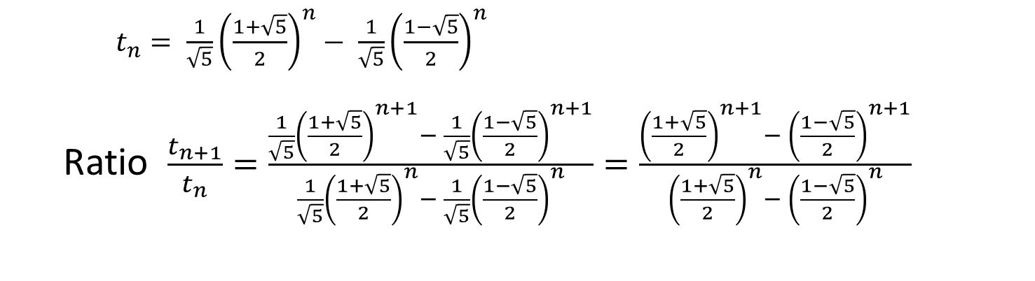
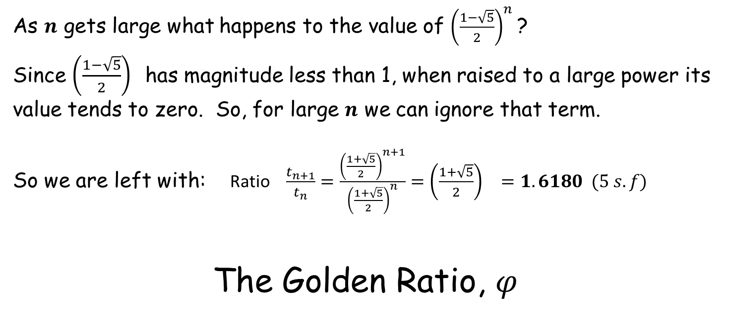
$t_{n}= \frac{1}{\sqrt{5}}{\left(\frac{1+\sqrt{5}}{2}\right)}^{n}− \frac{1}{\sqrt{5}}{\left(\frac{1−\sqrt{5}}{2}\right)}^{n}$
Ratio $\frac{t_{n+1}}{t_{n}}=\frac{\frac{1}{\sqrt{5}}{\left(\frac{1+\sqrt{5}}{2}\right)}^{n+1}− \frac{1}{\sqrt{5}}{\left(\frac{1−\sqrt{5}}{2}\right)}^{n+1}}{\frac{1}{\sqrt{5}}{\left(\frac{1+\sqrt{5}}{2}\right)}^{n}− \frac{1}{\sqrt{5}}{\left(\frac{1−\sqrt{5}}{2}\right)}^{n}}=\frac{{\left(\frac{1+\sqrt{5}}{2}\right)}^{n+1}− {\left(\frac{1−\sqrt{5}}{2}\right)}^{n+1}}{{\left(\frac{1+\sqrt{5}}{2}\right)}^{n}− {\left(\frac{1−\sqrt{5}}{2}\right)}^{n}}$
As $n$ gets large what happens to the value of ${\left(\frac{1−\sqrt{5}}{2}\right)}^{n}$ ?
Since ${\left(\frac{1−\sqrt{5}}{2}\right)}^{}$has magnitude less than 1, when raised to a large power its value tends to zero. So, for large $n$ we can ignore that term.
So we are left with: Ratio $\frac{t_{n+1}}{t_{n}}=\frac{{\left(\frac{1+\sqrt{5}}{2}\right)}^{n+1}}{{\left(\frac{1+\sqrt{5}}{2}\right)}^{n}}={\left(\frac{1+\sqrt{5}}{2}\right)}^{}=1.6180 (5 s.f)$
The Golden Ratio, $φ$

Slide 7
$t_{n}= \frac{1}{\sqrt{5}}{\left(\frac{1+\sqrt{5}}{2}\right)}^{n}− \frac{1}{\sqrt{5}}{\left(\frac{1−\sqrt{5}}{2}\right)}^{n}$
Ratio $\frac{t_{n+1}}{t_{n}}=\frac{\frac{1}{\sqrt{5}}{\left(\frac{1+\sqrt{5}}{2}\right)}^{n+1}− \frac{1}{\sqrt{5}}{\left(\frac{1−\sqrt{5}}{2}\right)}^{n+1}}{\frac{1}{\sqrt{5}}{\left(\frac{1+\sqrt{5}}{2}\right)}^{n}− \frac{1}{\sqrt{5}}{\left(\frac{1−\sqrt{5}}{2}\right)}^{n}}=\frac{{\left(\frac{1+\sqrt{5}}{2}\right)}^{n+1}− {\left(\frac{1−\sqrt{5}}{2}\right)}^{n+1}}{{\left(\frac{1+\sqrt{5}}{2}\right)}^{n}− {\left(\frac{1−\sqrt{5}}{2}\right)}^{n}}$
As $n$ gets large what happens to the value of ${\left(\frac{1−\sqrt{5}}{2}\right)}^{n}$ ?
Since ${\left(\frac{1−\sqrt{5}}{2}\right)}^{}$has magnitude less than 1, when raised to a large power its value tends to zero. So, for large $n$ we can ignore that term.
So we are left with: Ratio $\frac{t_{n+1}}{t_{n}}=\frac{{\left(\frac{1+\sqrt{5}}{2}\right)}^{n+1}}{{\left(\frac{1+\sqrt{5}}{2}\right)}^{n}}={\left(\frac{1+\sqrt{5}}{2}\right)}^{}=1.6180 (5 s.f)$
The Golden Ratio, $φ$

Slide 8
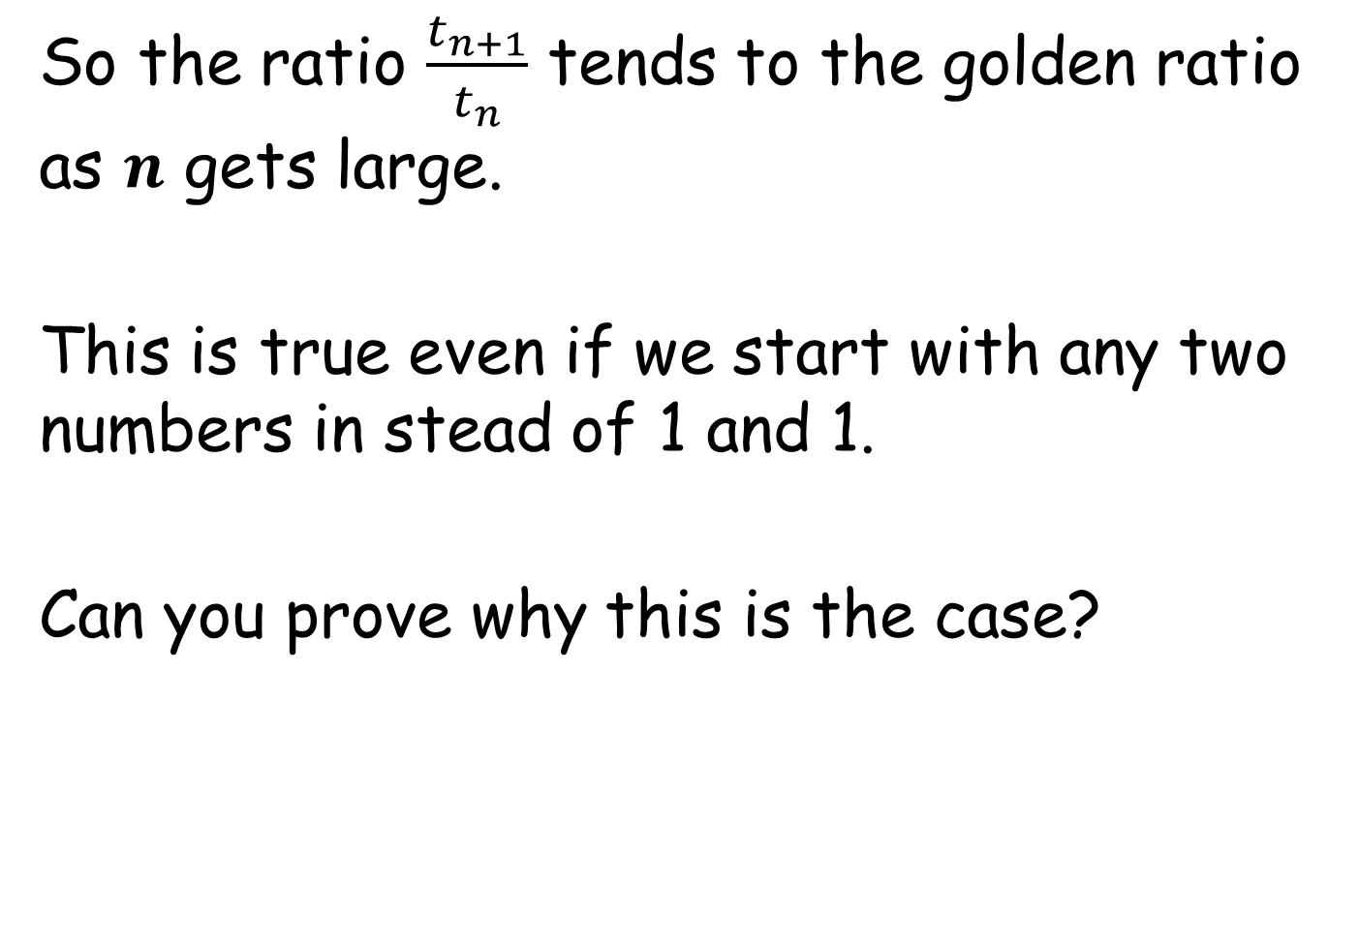
So the ratio $\frac{t_{n+1}}{t_{n}}$ tends to the golden ratio as $n$ gets large.
This is true even if we start with any two numbers in stead of 1 and 1.
Can you prove why this is the case?
Notes:
Go to spreadsheet to demonstrate. Any Fibonacci sequence can be shown to be made up of the sum of multiple classic Finonacci sequences but starting at different positions. Each one tends to the golden ratio.

Slide 9
5 | 9 | 14 | 23 | 37 | 60 | 97 | 157 | 254 | 411 | 665 | 1076 | 1741 | 2817
ratio
1.8 | 1.5556 | 1.6429 | 1.6087 | 1.6216 | 1.6167 | 1.6186 | 1.6178 | 1.6181 | 1.618 | 1.618 | 1.618 | 1.618
This sequence can be made from the addition of two multiples of the classic Fibonacci sequence.
Since the ratio of each one tends to the golden ratio so must the sum of them.
 | 5 | 5 | 10 | 15 | 25 | 40 | 65 | 105 | 170 | 275 | 445 | 720 | 1165 | 1885
+ |  | 4 | 4 | 8 | 12 | 20 | 32 | 52 | 84 | 136 | 220 | 356 | 576 | 932
= | 5 | 9 | 14 | 23 | 37 | 60 | 97 | 157 | 254 | 411 | 665 | 1076 | 1741 | 2817

Slide 11
RESOURCES

Slide 12
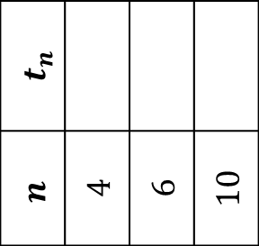
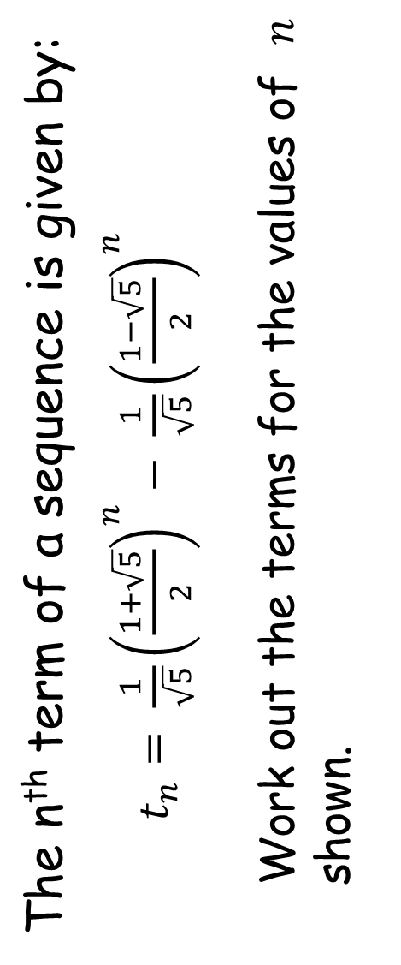
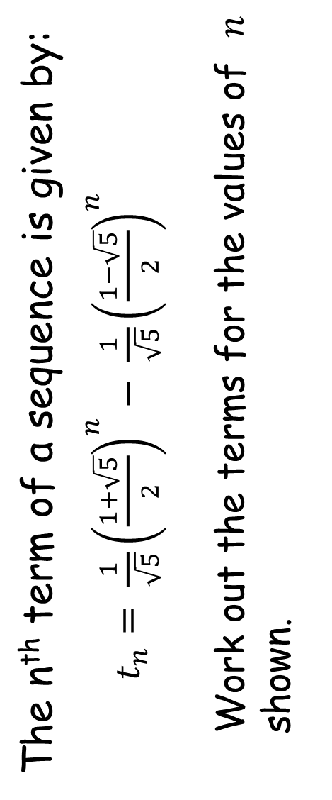
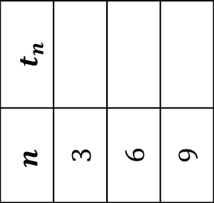
The n^{th} term of a sequence is given by:
$t_{n}= \frac{1}{\sqrt{5}}{\left(\frac{1+\sqrt{5}}{2}\right)}^{n}− \frac{1}{\sqrt{5}}{\left(\frac{1−\sqrt{5}}{2}\right)}^{n}$
Work out the terms for the values of $n$ shown.
The n^{th} term of a sequence is given by:
$t_{n}= \frac{1}{\sqrt{5}}{\left(\frac{1+\sqrt{5}}{2}\right)}^{n}− \frac{1}{\sqrt{5}}{\left(\frac{1−\sqrt{5}}{2}\right)}^{n}$
Work out the terms for the values of $n$ shown.
$$t_{n}$$
$$n$$ | $$4$$ | $$6$$ | $$10$$
$$t_{n}$$
$$n$$ | $$3$$ | $$6$$ | $$9$$
SIC_21
SIC_21

Slide 13
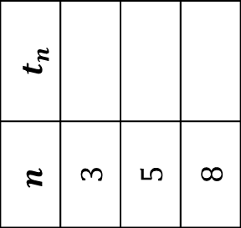
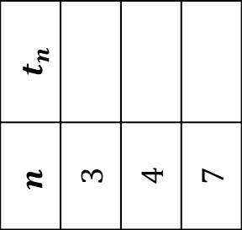
The n^{th} term of a sequence is given by:
$t_{n}= \frac{1}{\sqrt{5}}{\left(\frac{1+\sqrt{5}}{2}\right)}^{n}− \frac{1}{\sqrt{5}}{\left(\frac{1−\sqrt{5}}{2}\right)}^{n}$
Work out the terms for the values of $n$ shown.
The n^{th} term of a sequence is given by:
$t_{n}= \frac{1}{\sqrt{5}}{\left(\frac{1+\sqrt{5}}{2}\right)}^{n}− \frac{1}{\sqrt{5}}{\left(\frac{1−\sqrt{5}}{2}\right)}^{n}$
Work out the terms for the values of $n$ shown.
$$t_{n}$$
$$n$$ | $$3$$ | $$5$$ | $$8$$
$$t_{n}$$
$$n$$ | $$3$$ | $$4$$ | $$7$$
SIC_21
SIC_21

Slide 14
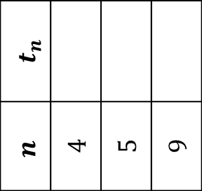
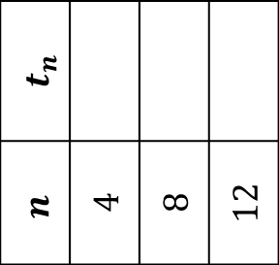
The n^{th} term of a sequence is given by:
$t_{n}= \frac{1}{\sqrt{5}}{\left(\frac{1+\sqrt{5}}{2}\right)}^{n}− \frac{1}{\sqrt{5}}{\left(\frac{1−\sqrt{5}}{2}\right)}^{n}$
Work out the terms for the values of $n$ shown.
The n^{th} term of a sequence is given by:
$t_{n}= \frac{1}{\sqrt{5}}{\left(\frac{1+\sqrt{5}}{2}\right)}^{n}− \frac{1}{\sqrt{5}}{\left(\frac{1−\sqrt{5}}{2}\right)}^{n}$
Work out the terms for the values of $n$ shown.
$$t_{n}$$
$$n$$ | $$4$$ | $$5$$ | $$9$$
$$t_{n}$$
$$n$$ | $$4$$ | $$8$$ | $$12$$
SIC_21
SIC_21

Slide 15
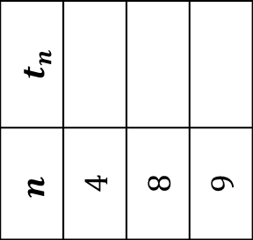
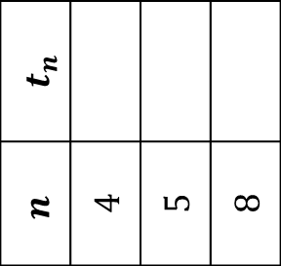
The n^{th} term of a sequence is given by:
$t_{n}= \frac{1}{\sqrt{5}}{\left(\frac{1+\sqrt{5}}{2}\right)}^{n}− \frac{1}{\sqrt{5}}{\left(\frac{1−\sqrt{5}}{2}\right)}^{n}$
Work out the terms for the values of $n$ shown.
The n^{th} term of a sequence is given by:
$t_{n}= \frac{1}{\sqrt{5}}{\left(\frac{1+\sqrt{5}}{2}\right)}^{n}− \frac{1}{\sqrt{5}}{\left(\frac{1−\sqrt{5}}{2}\right)}^{n}$
Work out the terms for the values of $n$ shown.
$$t_{n}$$
$$n$$ | $$4$$ | $$5$$ | $$8$$
$$t_{n}$$
$$n$$ | $$4$$ | $$8$$ | $$9$$
SIC_21
SIC_21

Slide 16
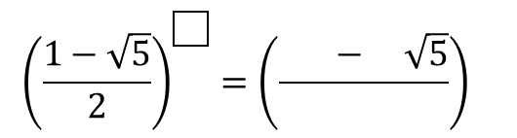
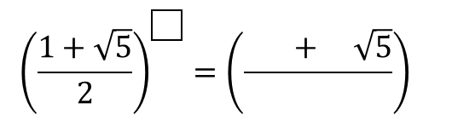
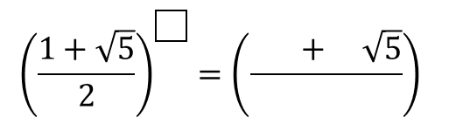
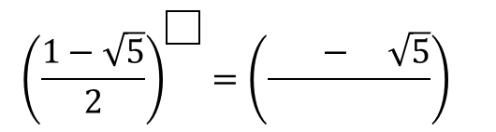
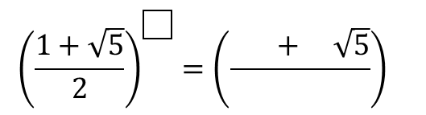
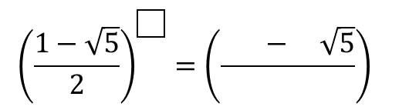
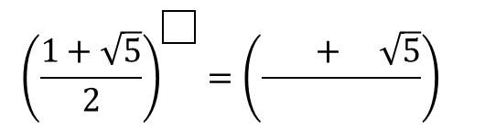
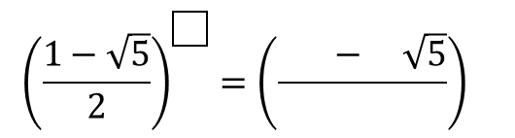
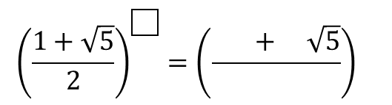
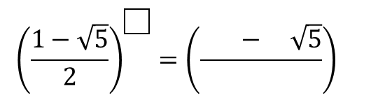
$${\left(\frac{1+\sqrt{5}}{2}\right)}^{\boxed{}}={\left(\frac{ + \sqrt{5}}{}\right)}^{}$$
$${\left(\frac{1−\sqrt{5}}{2}\right)}^{\boxed{}}={\left(\frac{ − \sqrt{5}}{}\right)}^{}$$
$${\left(\frac{1+\sqrt{5}}{2}\right)}^{\boxed{}}={\left(\frac{ + \sqrt{5}}{}\right)}^{}$$
$${\left(\frac{1−\sqrt{5}}{2}\right)}^{\boxed{}}={\left(\frac{ − \sqrt{5}}{}\right)}^{}$$
$${\left(\frac{1+\sqrt{5}}{2}\right)}^{\boxed{}}={\left(\frac{ + \sqrt{5}}{}\right)}^{}$$
$${\left(\frac{1−\sqrt{5}}{2}\right)}^{\boxed{}}={\left(\frac{ − \sqrt{5}}{}\right)}^{}$$
$${\left(\frac{1+\sqrt{5}}{2}\right)}^{\boxed{}}={\left(\frac{ + \sqrt{5}}{}\right)}^{}$$
$${\left(\frac{1−\sqrt{5}}{2}\right)}^{\boxed{}}={\left(\frac{ − \sqrt{5}}{}\right)}^{}$$
$${\left(\frac{1+\sqrt{5}}{2}\right)}^{\boxed{}}={\left(\frac{ + \sqrt{5}}{}\right)}^{}$$
$${\left(\frac{1−\sqrt{5}}{2}\right)}^{\boxed{}}={\left(\frac{ − \sqrt{5}}{}\right)}^{}$$
Notes:
For students to record values neatly

Slide 17
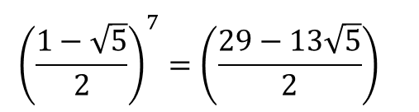
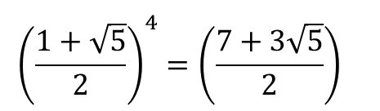
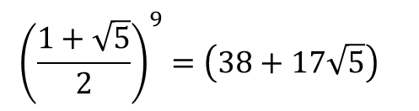
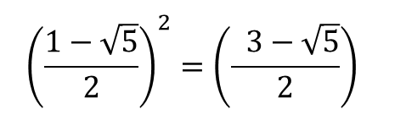
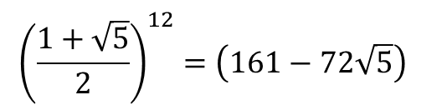
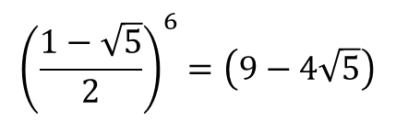
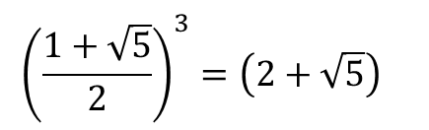
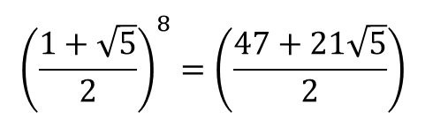
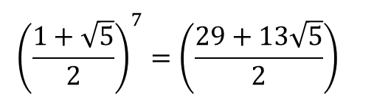
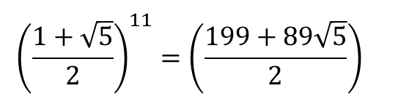
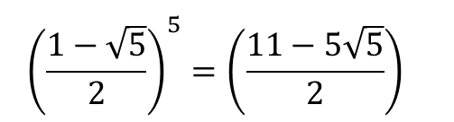
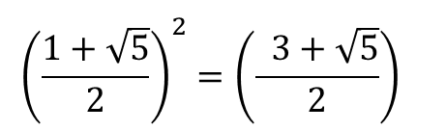
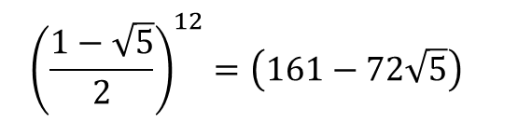
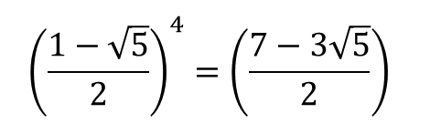
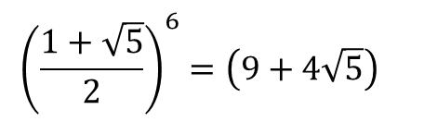
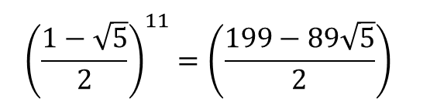
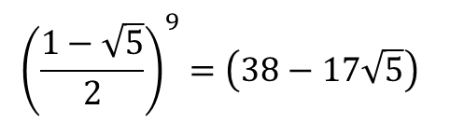
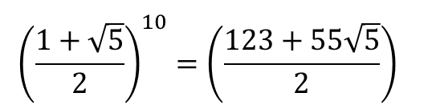
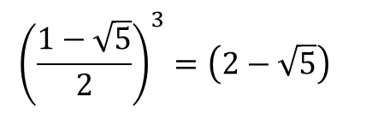
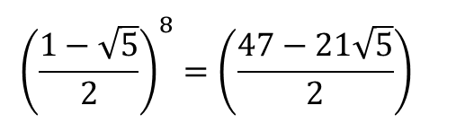


$${\left(\frac{1+\sqrt{5}}{2}\right)}^{2}={\left(\frac{ 3+\sqrt{5}}{2}\right)}^{}$$
$${\left(\frac{1+\sqrt{5}}{2}\right)}^{10}={\left(\frac{123+55\sqrt{5}}{2}\right)}^{}$$
$${\left(\frac{1−\sqrt{5}}{2}\right)}^{5}={\left(\frac{11−5\sqrt{5}}{2}\right)}^{}$$
$${\left(\frac{1+\sqrt{5}}{2}\right)}^{3}={\left(2+\sqrt{5}\right)}^{}$$
$${\left(\frac{1+\sqrt{5}}{2}\right)}^{11}={\left(\frac{199+89\sqrt{5}}{2}\right)}^{}$$
$${\left(\frac{1−\sqrt{5}}{2}\right)}^{6}={\left(9−4\sqrt{5}\right)}^{}$$
$${\left(\frac{1+\sqrt{5}}{2}\right)}^{4}={\left(\frac{7+3\sqrt{5}}{2}\right)}^{}$$
$${\left(\frac{1+\sqrt{5}}{2}\right)}^{12}={\left(161−72\sqrt{5}\right)}^{}$$
$${\left(\frac{1−\sqrt{5}}{2}\right)}^{7}={\left(\frac{29−13\sqrt{5}}{2}\right)}^{}$$
$${\left(\frac{1+\sqrt{5}}{2}\right)}^{5}={\left(\frac{11+5\sqrt{5}}{2}\right)}^{}$$
$${\left(\frac{1−\sqrt{5}}{2}\right)}^{8}={\left(\frac{47−21\sqrt{5}}{2}\right)}^{}$$
$${\left(\frac{1+\sqrt{5}}{2}\right)}^{6}={\left(9+4\sqrt{5}\right)}^{}$$
$${\left(\frac{1−\sqrt{5}}{2}\right)}^{9}={\left(38−17\sqrt{5}\right)}^{}$$
$${\left(\frac{1+\sqrt{5}}{2}\right)}^{7}={\left(\frac{29+13\sqrt{5}}{2}\right)}^{}$$
$${\left(\frac{1−\sqrt{5}}{2}\right)}^{2}={\left(\frac{ 3−\sqrt{5}}{2}\right)}^{}$$
$${\left(\frac{1−\sqrt{5}}{2}\right)}^{10}={\left(\frac{123−55\sqrt{5}}{2}\right)}^{}$$
$${\left(\frac{1+\sqrt{5}}{2}\right)}^{8}={\left(\frac{47+21\sqrt{5}}{2}\right)}^{}$$
$${\left(\frac{1−\sqrt{5}}{2}\right)}^{3}={\left(2−\sqrt{5}\right)}^{}$$
$${\left(\frac{1−\sqrt{5}}{2}\right)}^{11}={\left(\frac{199−89\sqrt{5}}{2}\right)}^{}$$
$${\left(\frac{1+\sqrt{5}}{2}\right)}^{9}={\left(38+17\sqrt{5}\right)}^{}$$
$${\left(\frac{1−\sqrt{5}}{2}\right)}^{4}={\left(\frac{7−3\sqrt{5}}{2}\right)}^{}$$
$${\left(\frac{1−\sqrt{5}}{2}\right)}^{12}={\left(161−72\sqrt{5}\right)}^{}$$
Notes:
Crib sheet for Teacher

